Slide 1
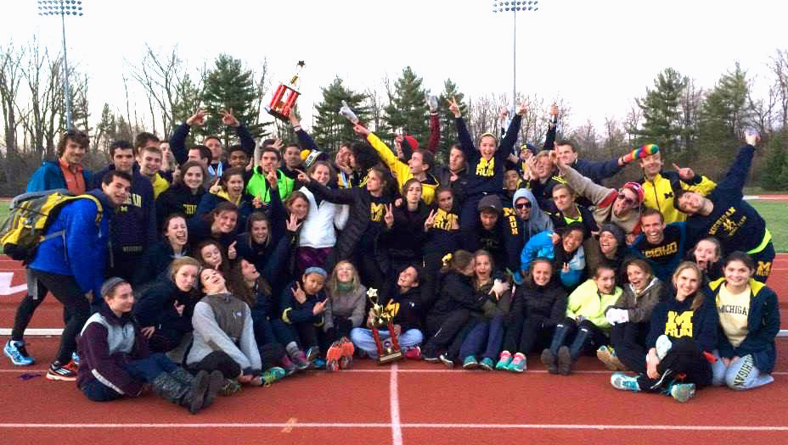
MRun Mass Meeting
Winter 2015!

Slide 2
Board Introductions
Harrison Clark
President
Rob Rose
Treasurer
Caci Dishman
Vice President
John Holmes
Distance Training
Tyler Kristoff
Sprint & Field Training
Connor Murray
Travel Coordinator
Danny Sack
Social Events
Kira Burnett
Social Events
Sarah Hayes
Community Service
Shannon Peterson
RAM Coordinator
Cassie Hoffman
Marketing & Fundraising
Eli Jenkinson
S.W.A.G.
Taylor Flynn
RAM Coordinator
Thomas Finch
Webmaster
Emily Southern
Liaison to Club Sports

Slide 3
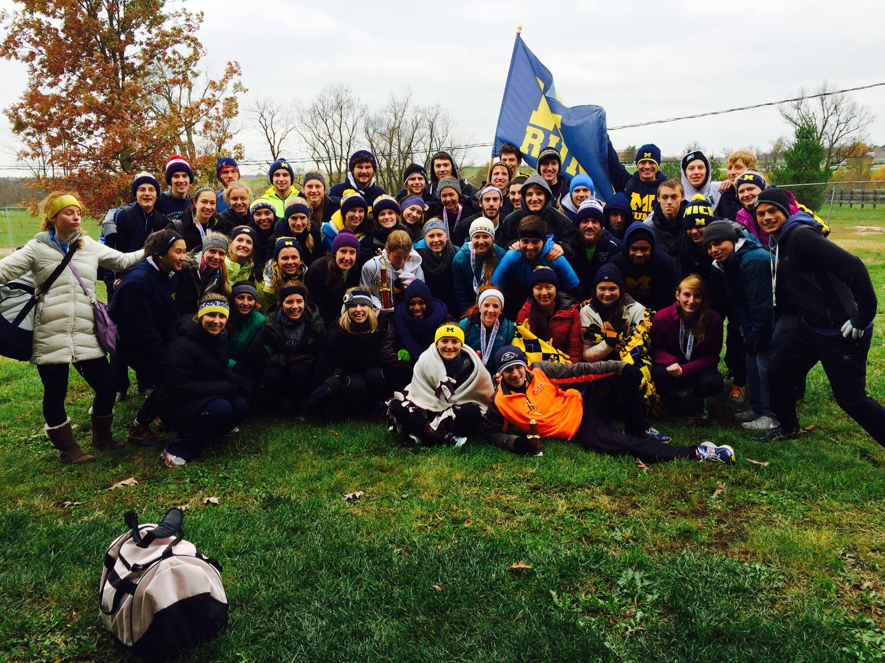
How does MRun work?
• Daily Practices • Social Events
• Cross Country • Track & Field
• Community Service • Family & Fun!

Slide 4
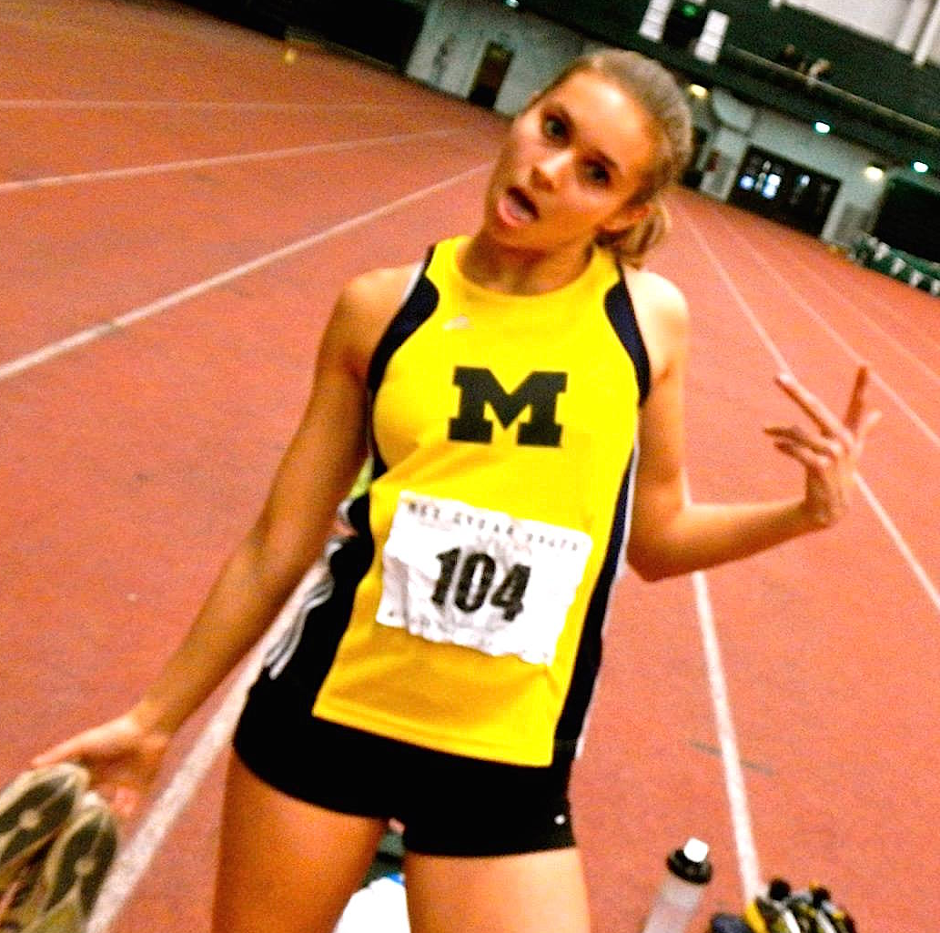
Practices & Workouts
Daily runs at 4:15pm @ CCRB Monday-Friday:
3, 5, and 7 mi routes
Weekend runs at 10:15am @ CCRB Sunday:
3, 6, 9, 12+ mi routes
Workouts:
Tuesdays/Thursdays at
8:30pm @ Indoor Track
EVERYTHING IS OPTIONAL
We have ALL ability levels

Slide 5
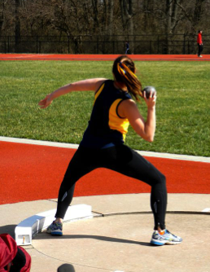
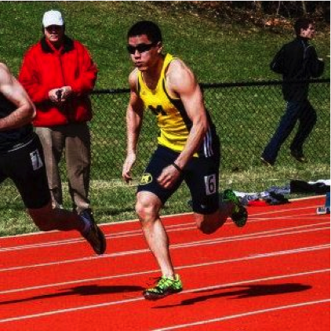
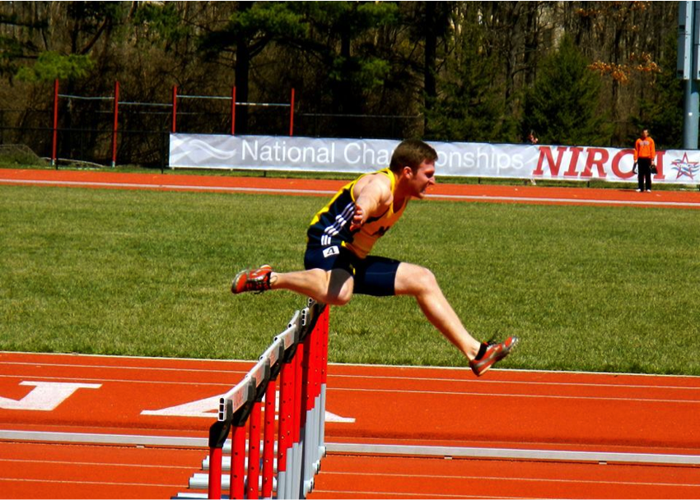
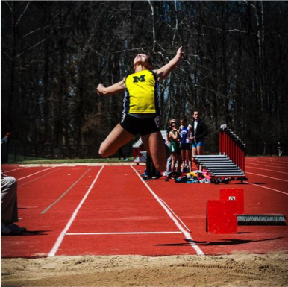
Track & Field
This Semester:
Tuesday and Thursday at 8:30pm @ Indoor Track
Monday and Wednesday at 9:00pm @ CCRB Lobby
Sprints and Hurdles
Field Events
Long Jump, High Jump, Shotput, Discus

Slide 6

Track Meets
January 31: SVSU ($10)
Division II varsity meet. Tends to be competitive - great chance for a fast race!
February 14 (<3): Happy Valley Invitational ($45)
Club meet at Penn State University, includes night in a 5 star hotel
Fun meet, fancy banked track, great for all ability levels.
February 28: Illinois Club Relays ($35)
Great way to start spring break!
March ?: MSU? Miami of OH? ($dolla dolla bills y’all)
Waiting on little brother ☹
April 11: NIRCA NATIONALS! ($30)
Includes all track and field events, AND a half marathon!
Literally the most fun you will ever have
Literally
many affordable, wow
TWO opportunities to race after nationals:
April 17: GVSU, Division II meet
April 23-25, GINA Relays, Division II meet, 3 days long

Slide 7
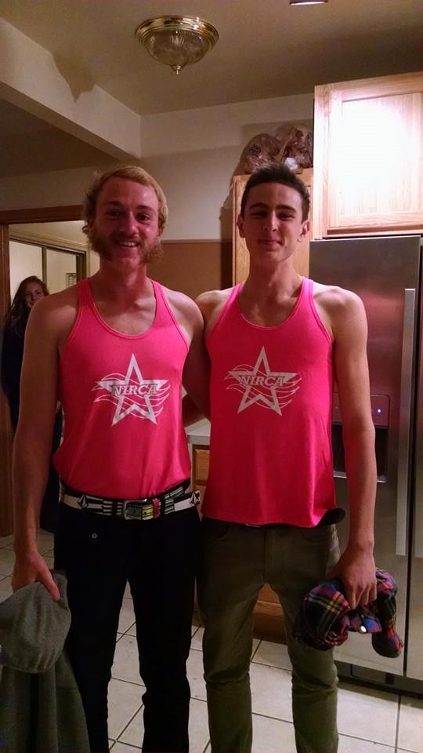
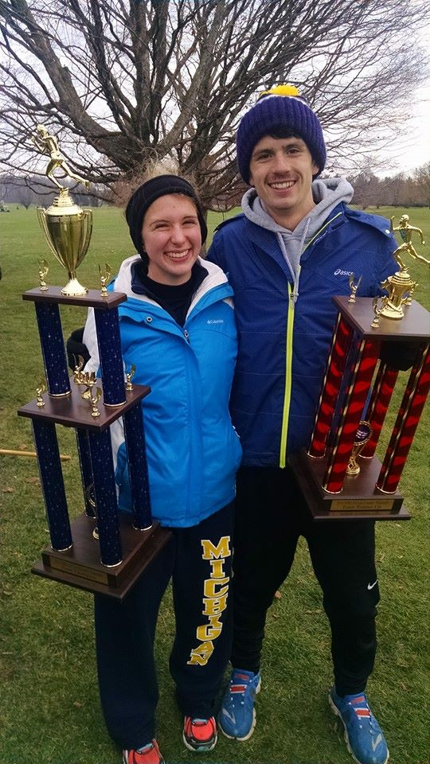
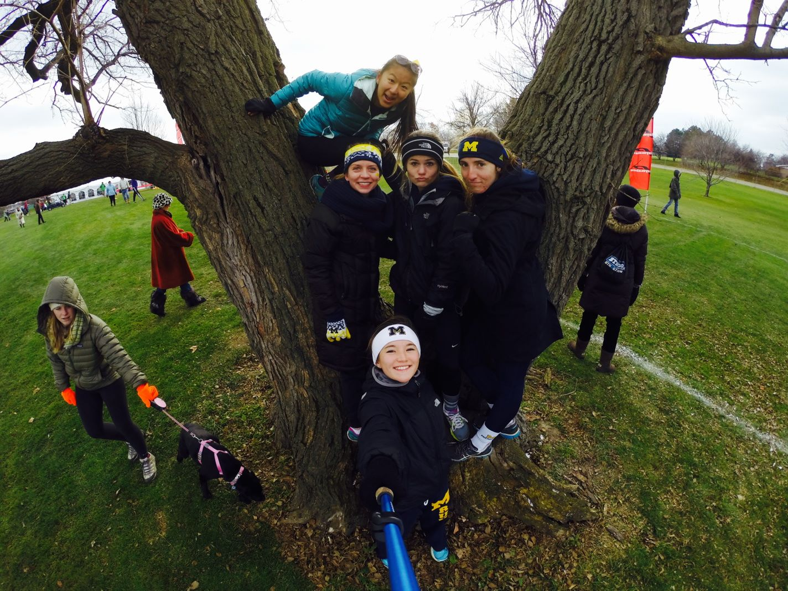
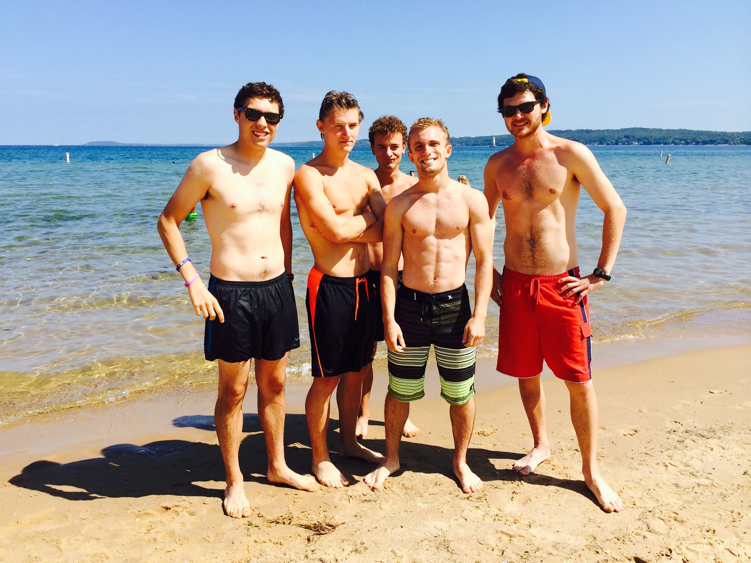
Social Events
02/01 - Suberb Owl Potluck
02/21 - Valentine’s Day <3
03/14 - RAM FUNdraiser
03/28 - Talent Show
04/17 - Mrun Prom

Slide 8
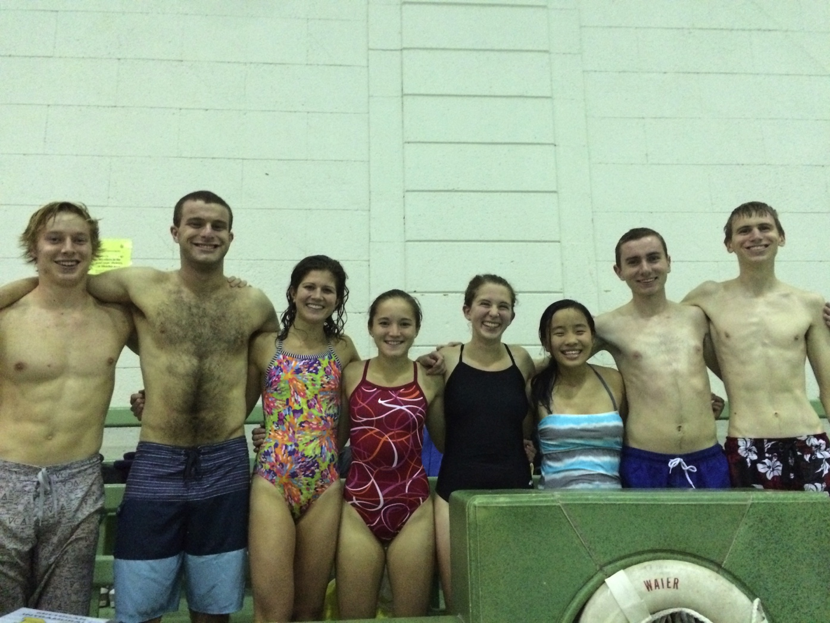
IM Sports
Low key and FUN!
Great way to hang out with MRunners outside of practice
Only ~1 hour of time commitment a week
Indoor Soccer
January 18th – February 26th
Tuesdays @ 5:30pm
Broomball
March 15th – April 20th

Slide 9
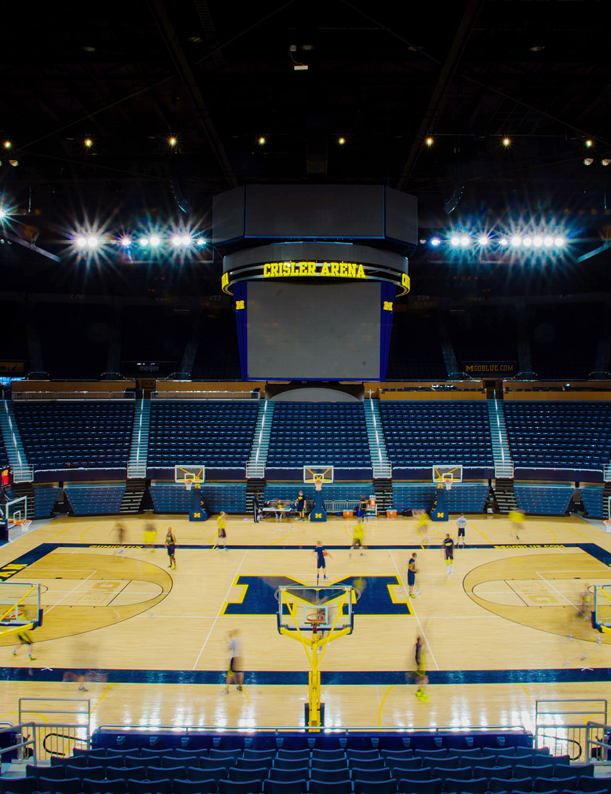


Marketing & Fundraising

Slide 10
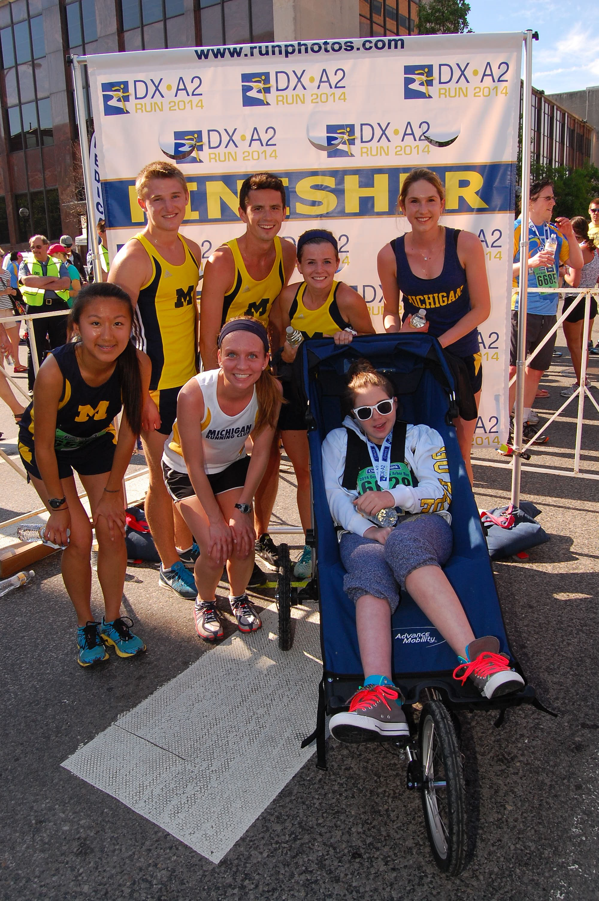


Community Service

Slide 11
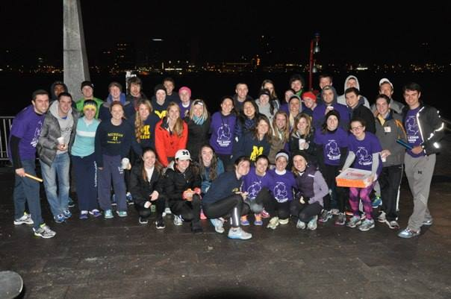
RAM – Race Across Michigan
Who? MRun!!
What? A 24-hour relay race across Michigan (182 miles!)
Where? Detroit -> -> -> South Haven
When? 6am March 21st – 1pm March 22nd
Why? To fundraise for the Special Olympics of Washtenaw County!!
How? Come to our mass meeting!
Have a question about what will be the best 24 hours of your life??
Talk to Taylor or Shannon
ramcoordinators@umich.edu

Slide 12
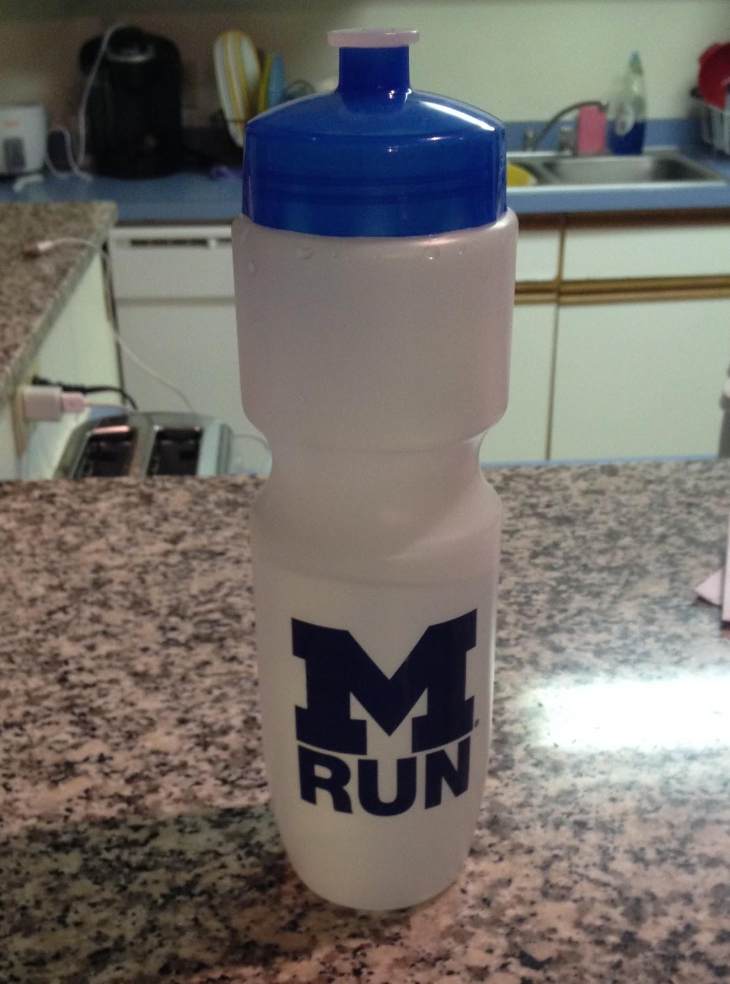
Dues
Dues are only $30!!
Cheapest Club Sport
Winter Semester
Subsidizes:
Social Events
Apparel
Traveling / Racing
Fun!
Free water bottle or wristband!

Slide 13
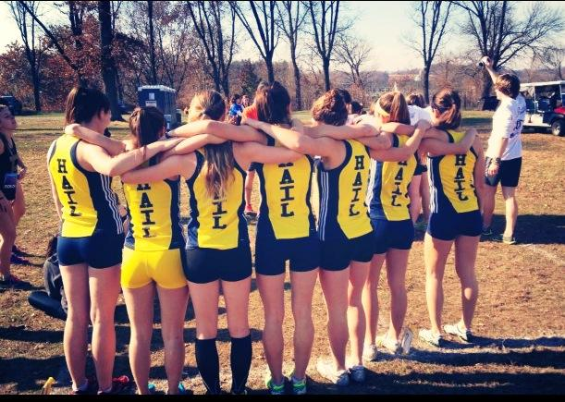
Maize Pages
Pay dues --> MRun roster on Maize Pages
Participation Agreement: you must upload a photo of your health insurance card
Health insurance is required for participation in Club Sports
Must fill out Participation Agreement on Maize Pages by 1-26, or before competing!

Slide 14
Questions?
mrun.clubrunning.org (mrun.sexy)
Lots of good information:
Practice times/locations
Meet schedule & social calendar
Routes and records
Contact information

Slide 15
MRun Apparel and Gear!
Winter 2015

Slide 16
How It Works
Pay right now with cash or check along with your dues.
Some items are in stock; others will be ordered in the near future.
As things arrive, I will make announcements on CTools/Facebook and hold office hours, usually before/after practice.
Contact: mrun.swag@umich.edu with any questions or to buy more gear.

Slide 17
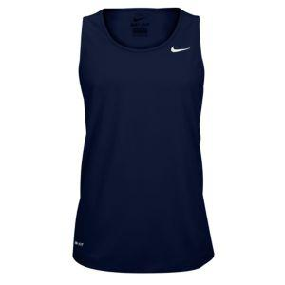

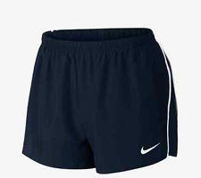
New Uniforms!
Men’s and women’s fit singlets - $20
Men’s and women’s fit shorts - $20

Slide 18


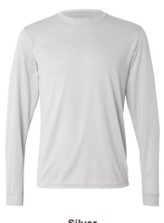
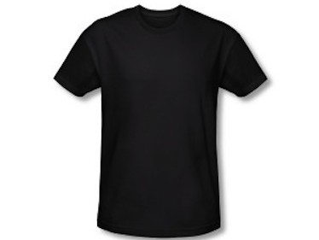
New Short / Long Sleeve Tech Shirts
Unisex short sleeve - $15
Unisex long sleeve - $20

Slide 19
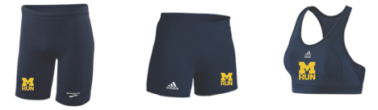
Half Tights / Spandex / Sports Bras
Men's half tights - $20
Women's half tights/spandex - $20
Sports Bras - $20

Slide 20
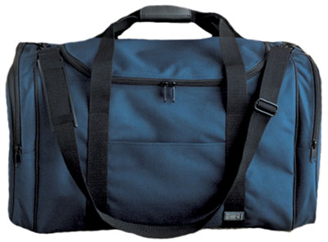
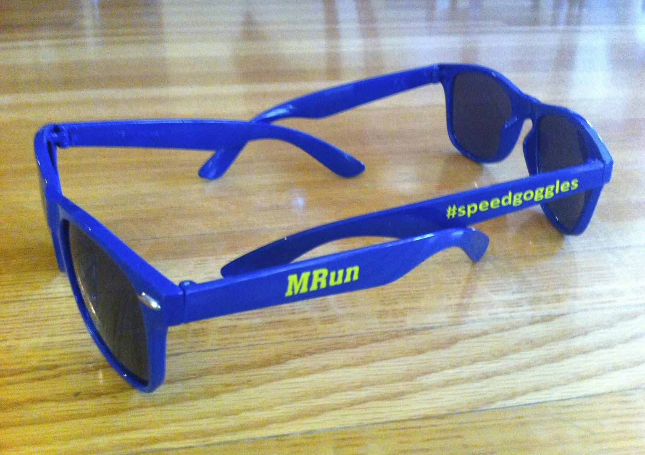

Accessories
Stickers - $1
Sunglasses - $5
Duffle Bags - $20

Slide 21
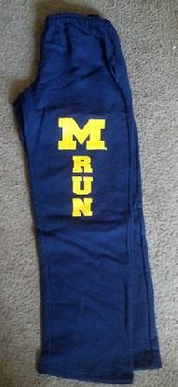
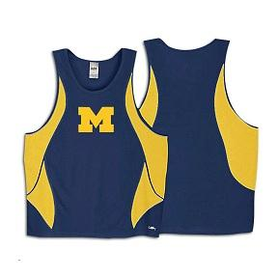
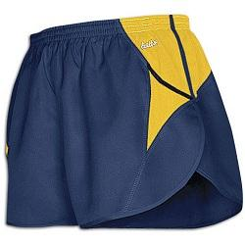
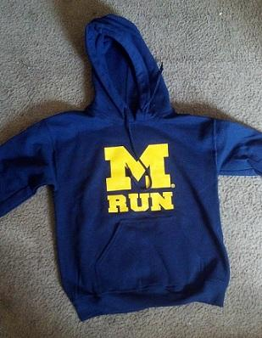
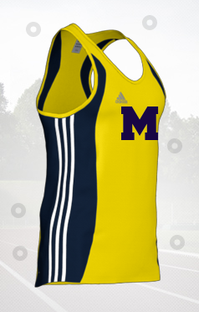

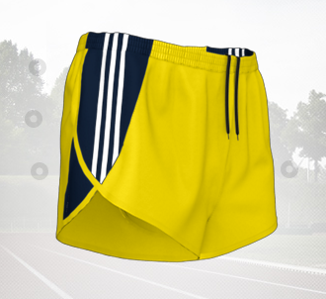
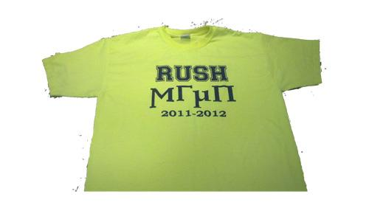


Limited Stock

Slide 22
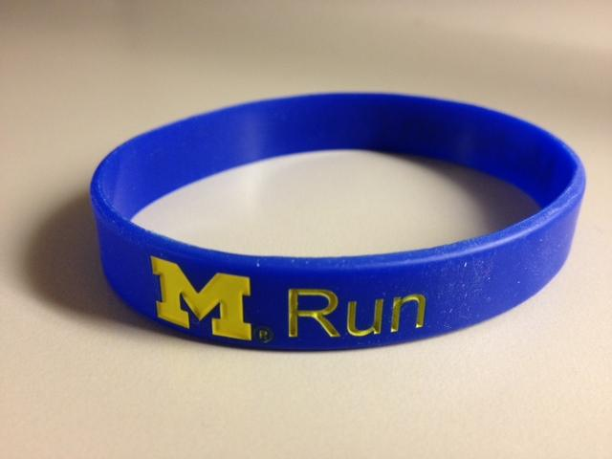
Water Bottles / Wristbands
FREE - Pick either a water bottle or wristband when you pay your dues!

Slide 23
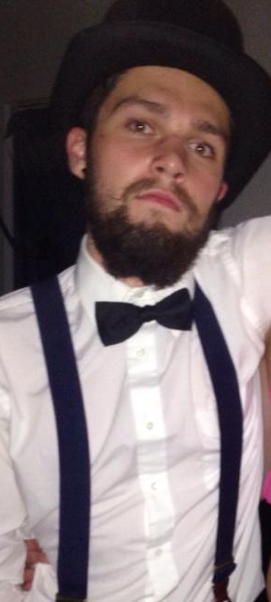
Questions?

